Slide 1
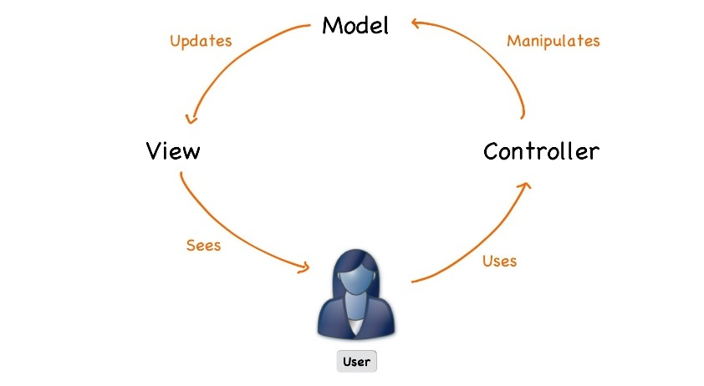



Spring Fundamentals
Course Introduction
SoftUni Team
Technical Trainers
Software University
https://softuni.bg

Slide 2
Table of Contents
Course Objectives & Program
The Trainers Team
Course Organization
Exam
Resources

Slide 3
Questions
sli.do #java-web

Slide 4












SoftUni Diamond Partners

Slide 5


Educational Partners

Slide 6

Course Objectives & Program
Spring Fundamentals

Slide 7


Spring Fundamentals – Course Program (1)
Course Introduction: Course Program, Trainers, Exams,
Resources
Mini Course HTML & CSS: Two lectures and one workshop
Internet Explained: OSI Model, Network Hardware
HTTP Protocol: HTTP Protocol Intro, Requests, Responses
Spring Boot Introduction: Spring Boot and Revision of Spring Data
Spring Introduction MVC: IoC, Layers and Thin Controllers
Workshop
State Management: Cookies, HTTP Sessions

Slide 8
Spring Fundamentals – Course Program (2)
Spring Essentials: Thymeleaf and Spring Controllers
Thymeleaf and Validations: Thymeleaf advanced functions and Validations
Front End Basics: Basic work with bootstrap and JavaScript.
Exam Preparation
Workshop
Exam

Slide 9

The Trainers Team

Slide 10
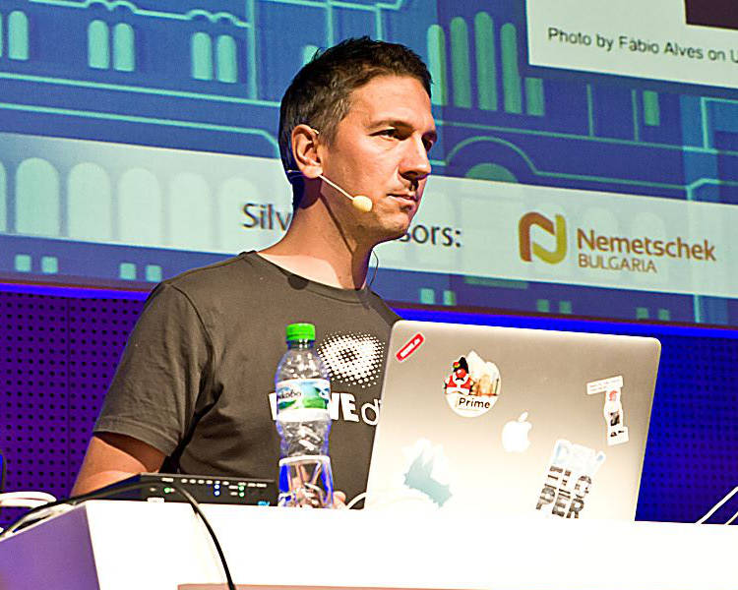
Lachezar Balev
Software engineer with 20+ years of real experience with different projects.
Started developing with Java in the year 2000 in the form of J2SE 1.2
Works in REWE Digital Bulgaria on an architecture focused on microservices
Uses Java, TypeScript and Kotlin in his daily tasks
Rides a motorcycle and climbs mountains in his spare time
Personal website: http://balev.eu/

Slide 11
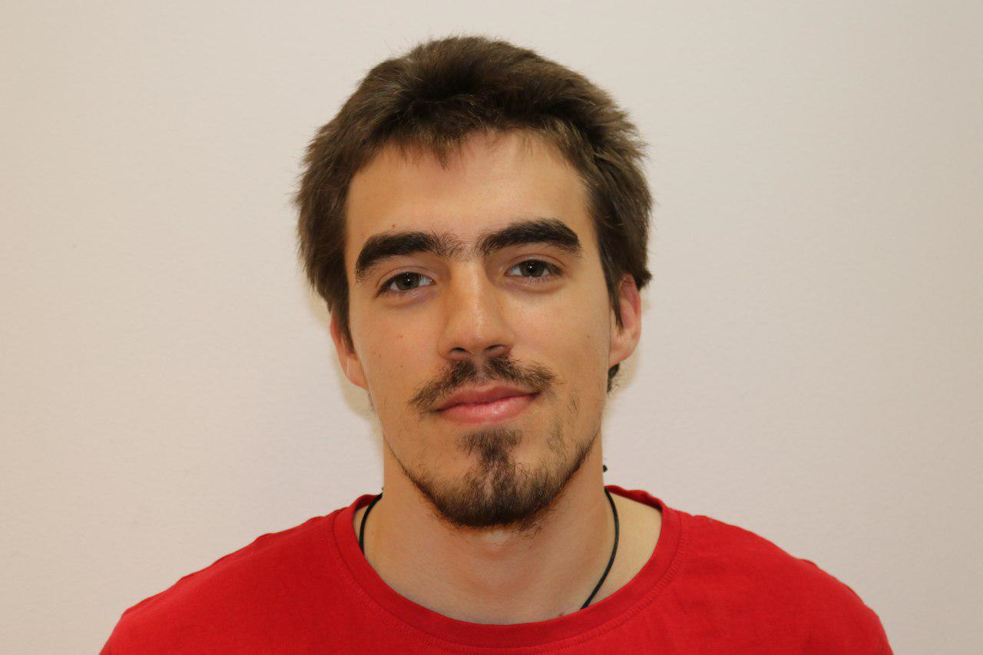
Nikolay Bankin
Top performing student from the Software University (2014)
8 years of programming experience
Teacher at TUES
Expirienced with Java, Scala, JavaScript and other platforms and technologies.

Slide 12

Course Organization

Slide 13
Java Web Module at SoftUni – Timeline
16-May-2022
27-Jun-2022
13-Aug-2022
Spring Fundamentals
Lessons + exam
6 weeks * 2 times / week
12 credits
Start: 16-May-2022
Theoretical Exam: 25-Jun-2022
Exam: 25-Jun-2022
Spring Advanced
Lessons + exam
6 weeks * 2 times / week
18 credits
Start: 27-Jun-2022
Theoretical Exam: 13-Aug-2022
Project Defense: 13-Aug-2022
Re-Take Exams
Fundamentals: 17-Aug-2022
Advanced: 21-Aug-2022

Slide 14


SoftUni Certificate
Practical Exam 100%
Evaluation
14

Slide 15
CPE Certificate
Practical Exam
Theoretical Exam
Evaluation
15

Slide 16

Exam
Practical web development exam
Implementing a simple web application using Spring Framework
Given a portion of the Views in a raw form
Duration: 4 hours
Solutions are evaluated by hand after the exam

Slide 17
Theoretical Exam
Test for 30 minutes
Multiple-choice with one correct answers
English
Automated quiz system
Available online the day of the practical exam
You can submit your answer just one time

Slide 18



Learn to Search in Internet
The course assignments require to search in Internet
This is an important part of the learning process
Some exercises intentionally have no hints
Learn to find solutions!
Software development includes everyday searching and learning
No excuses, just learn to study!
Developers learn new technologies, tools, languages every day!

Slide 19
Resources
What We Need Additionally?

Slide 20



Spring Fundamentals: Web Site, Forum, FB Group
Official web site:
Official discussion forum:
Official Facebook group:
Community Facebook group:
https://softuni.bg/trainings/3710/spring-fundamentals-may-2022
https://softuni.bg/forum/categories/72/java-web
https://www.facebook.com/groups/javawebmay2022
https://www.facebook.com/groups/SoftUniJavaCommunity/

Slide 21


Spring Fundamentals Slides and Videos
All lecture slides, videos, homework assignments, projects and other resources are open content, available for free
Visit the course web site to access the course resources

Slide 22
Questions?
Notes:
22

Slide 23
Trainings @ Software University (SoftUni)
Software University – High-Quality Education, Profession and Job for Software Developers
softuni.bg, about.softuni.bg
Software University Foundation
softuni.foundation
Software University @ Facebook
facebook.com/SoftwareUniversity
Software University Forums
forum.softuni.bg
Notes:
23

Slide 24

License
This course (slides, examples, demos, exercises, homework, documents, videos and other assets) is copyrighted content
Unauthorized copy, reproduction or use is illegal
© SoftUni – https://about.softuni.bg/
© Software University – https://softuni.bg
Notes:
24

